Slide 1
NM ASSIGNMENT 1
Done by Yogeshwar R
Data Set Link: Supermarket sales (kaggle.com)

Slide 2
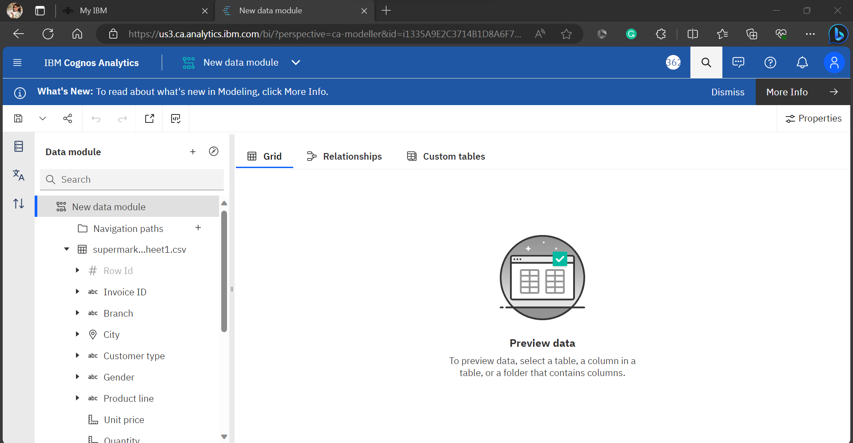
Step 1 : Create a new data module from the uploaded CSV file for visualizing data

Slide 3
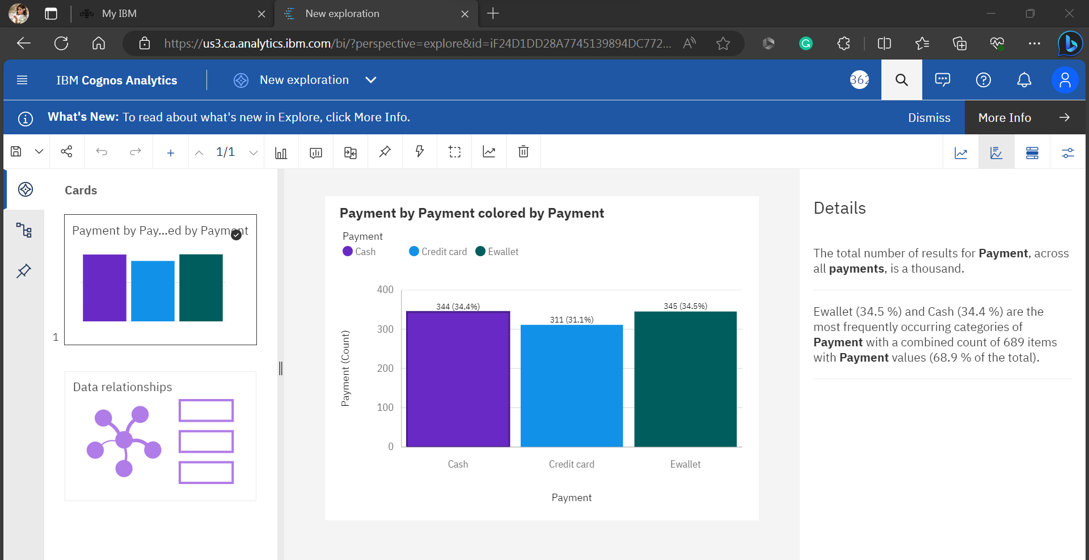
Step 2 : Using data module , create more explorations and pin it.

Slide 4
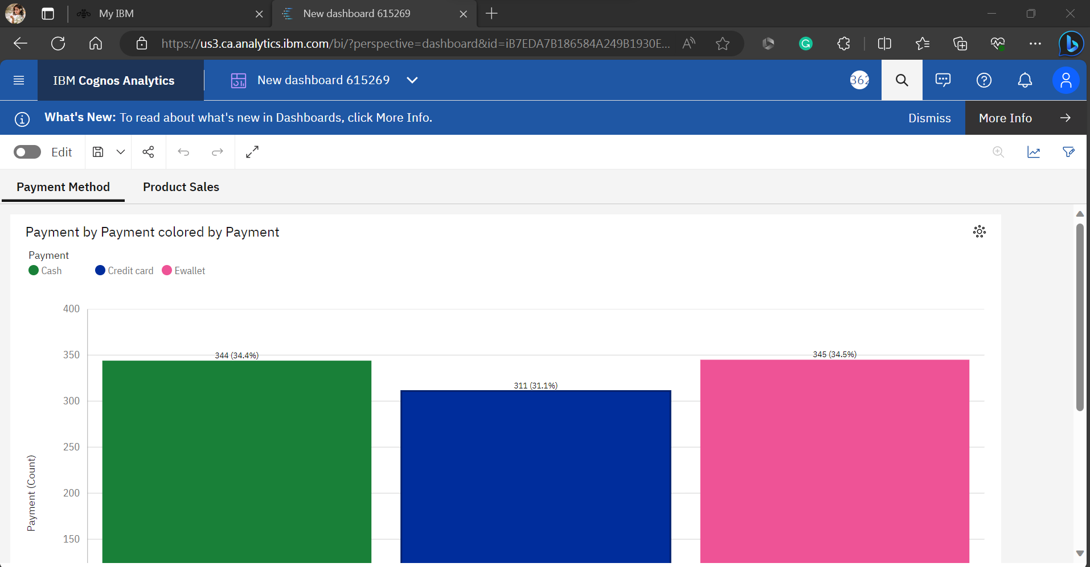
Step 3 : Using the pins, create Dashboard

Slide 5
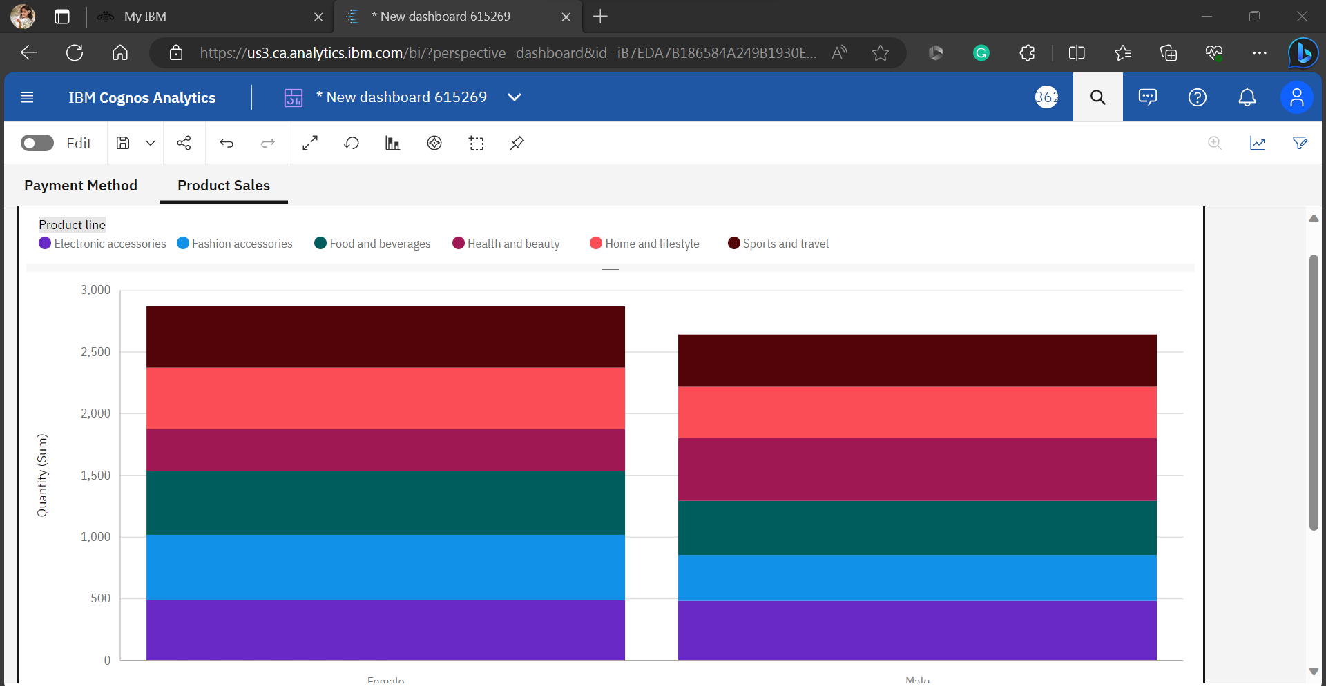

Slide 6
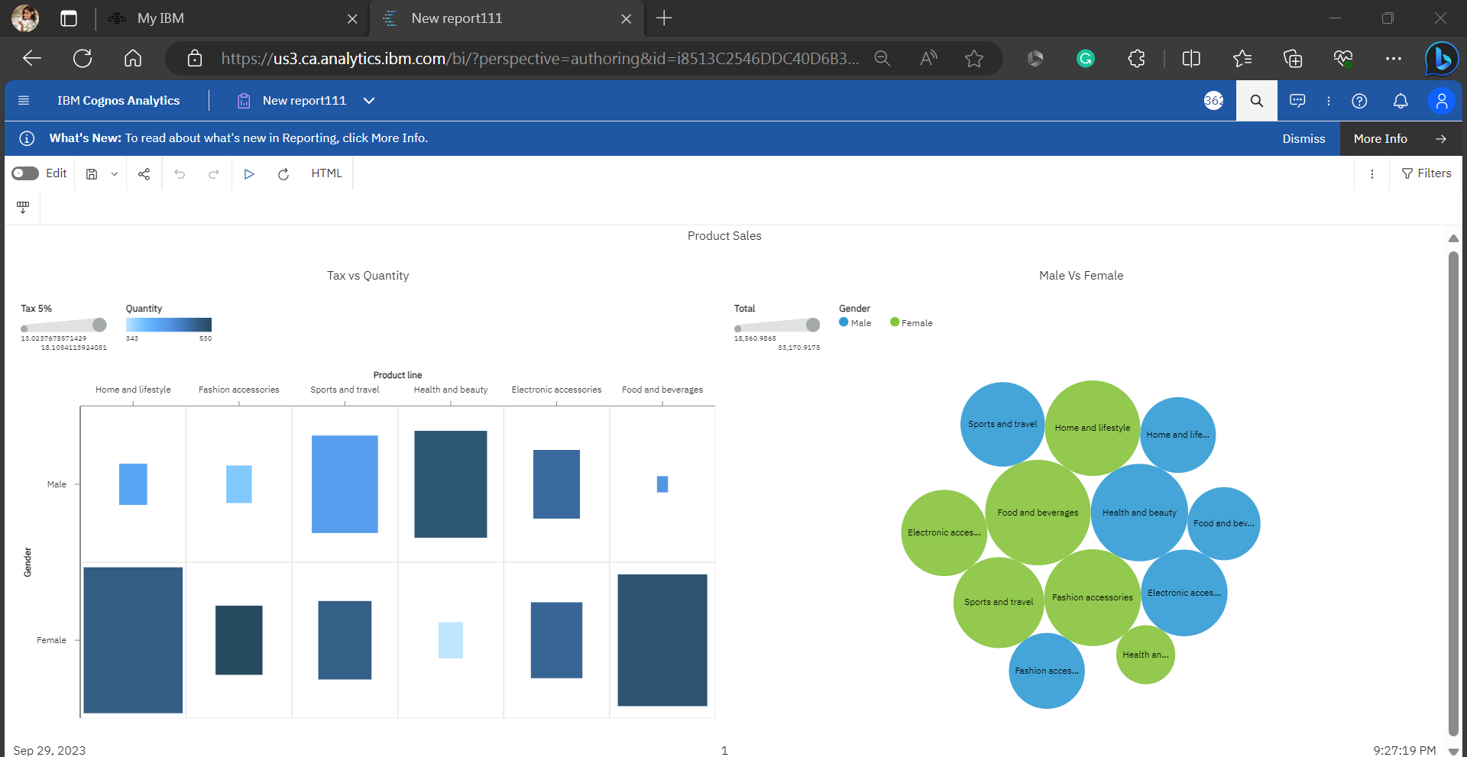
Step 4 : After done with that dashboard, Now create a report.

Slide 7
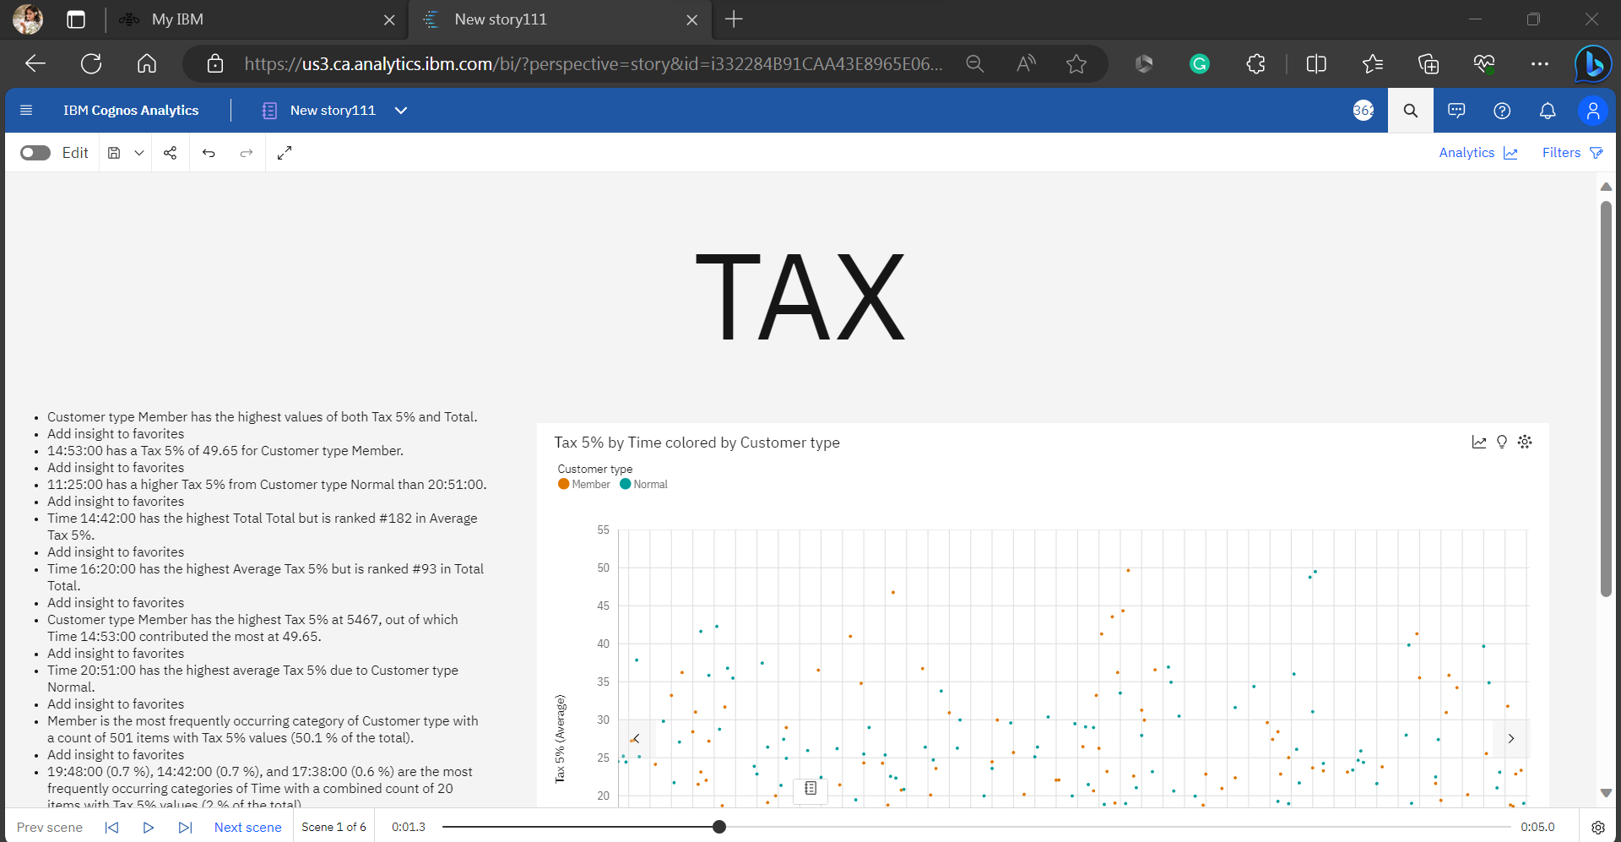
Step 5: After done with that report, Create a story to view our visualizations in the form of slides.

Slide 8
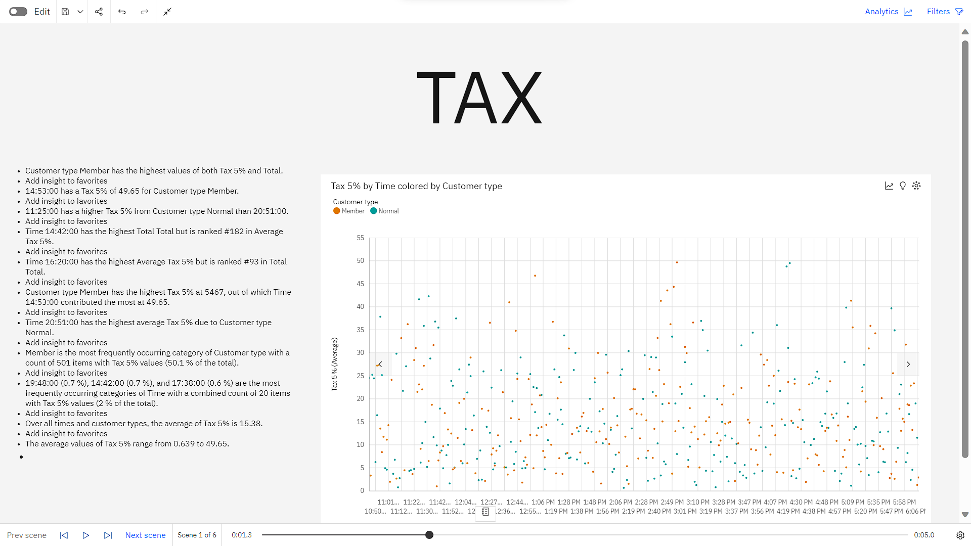

Slide 9
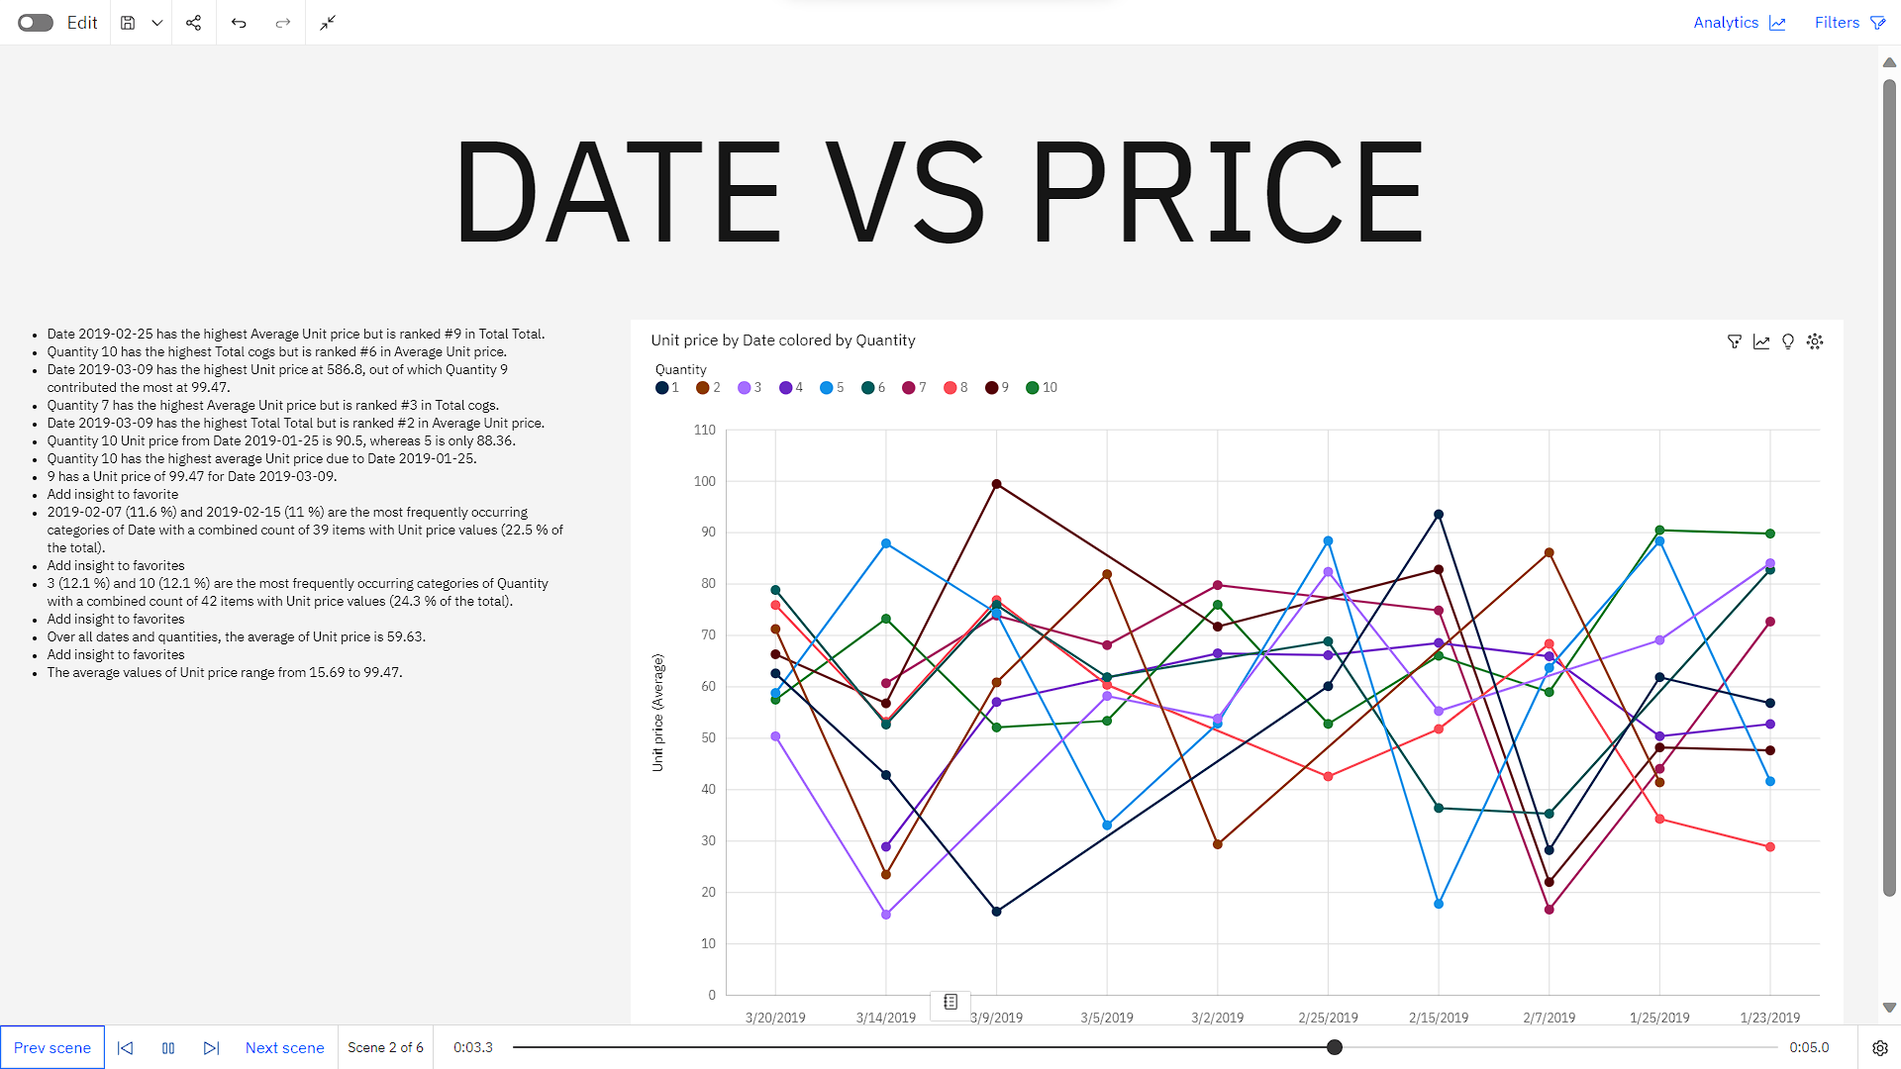

Slide 10
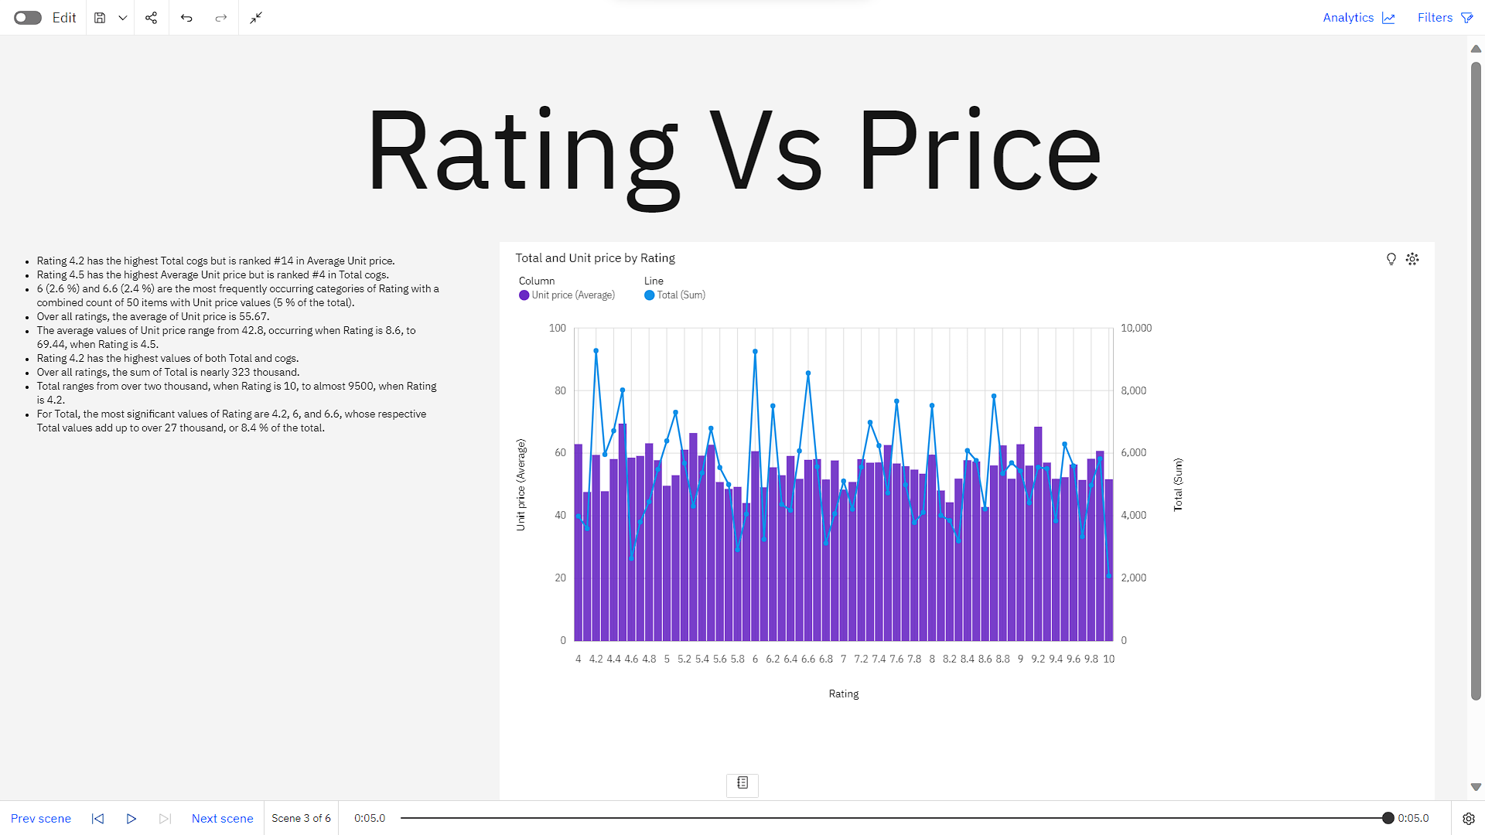

Slide 11
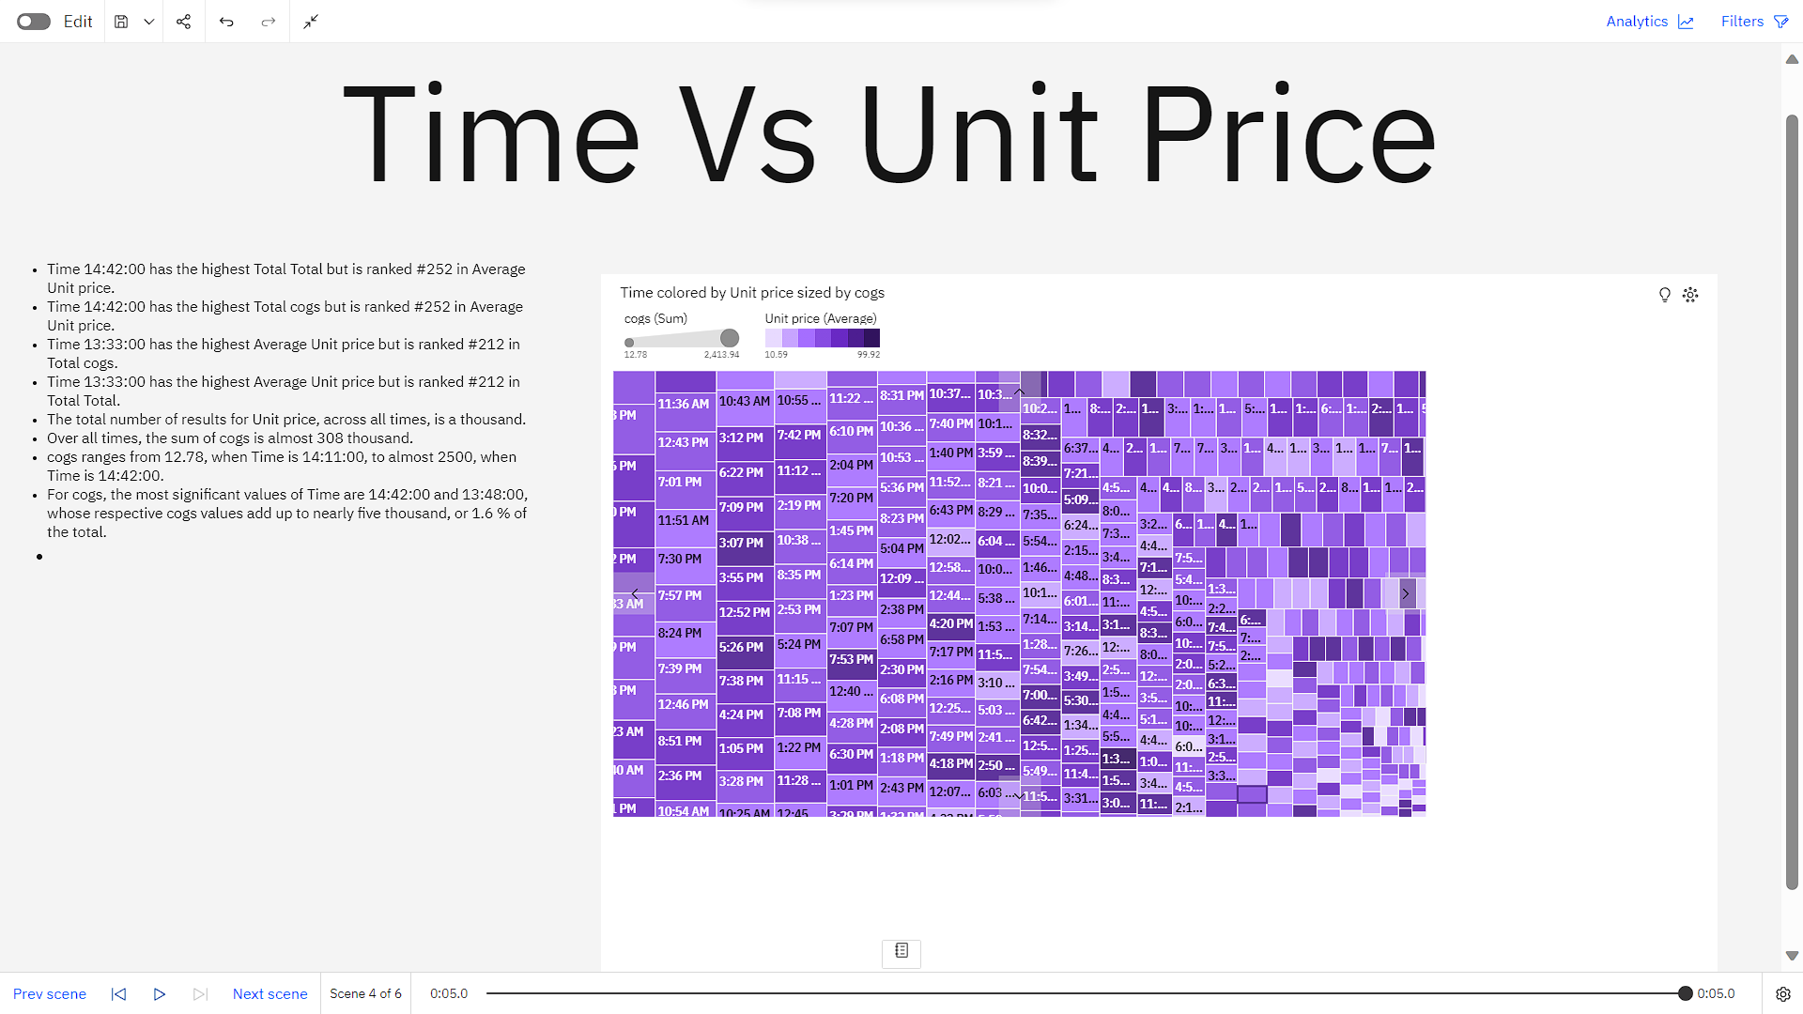

Slide 12
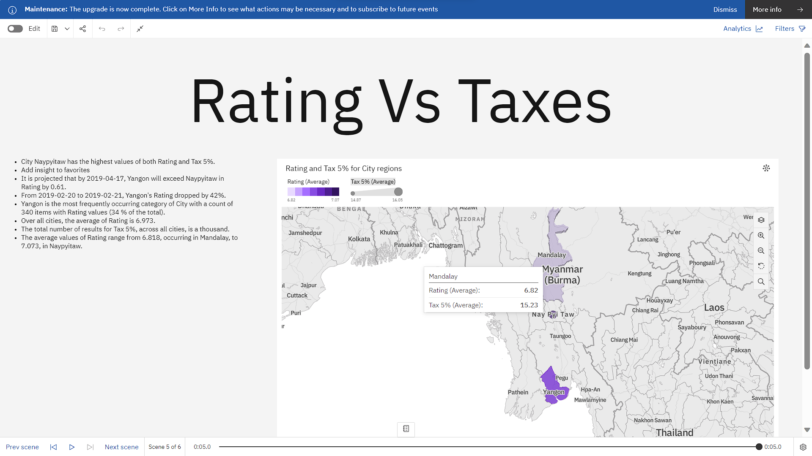

Slide 13
